Slide 1
MICE to Synthesize Generating Synthetic Data Sets with MICE for the Analysis of Private Data
Mirthe Hendriks
Master’s Thesis Applied Data Science

Slide 2
Problem
Privacy-preservation vs. Data sharing
Solution? Synthetic data

Slide 3
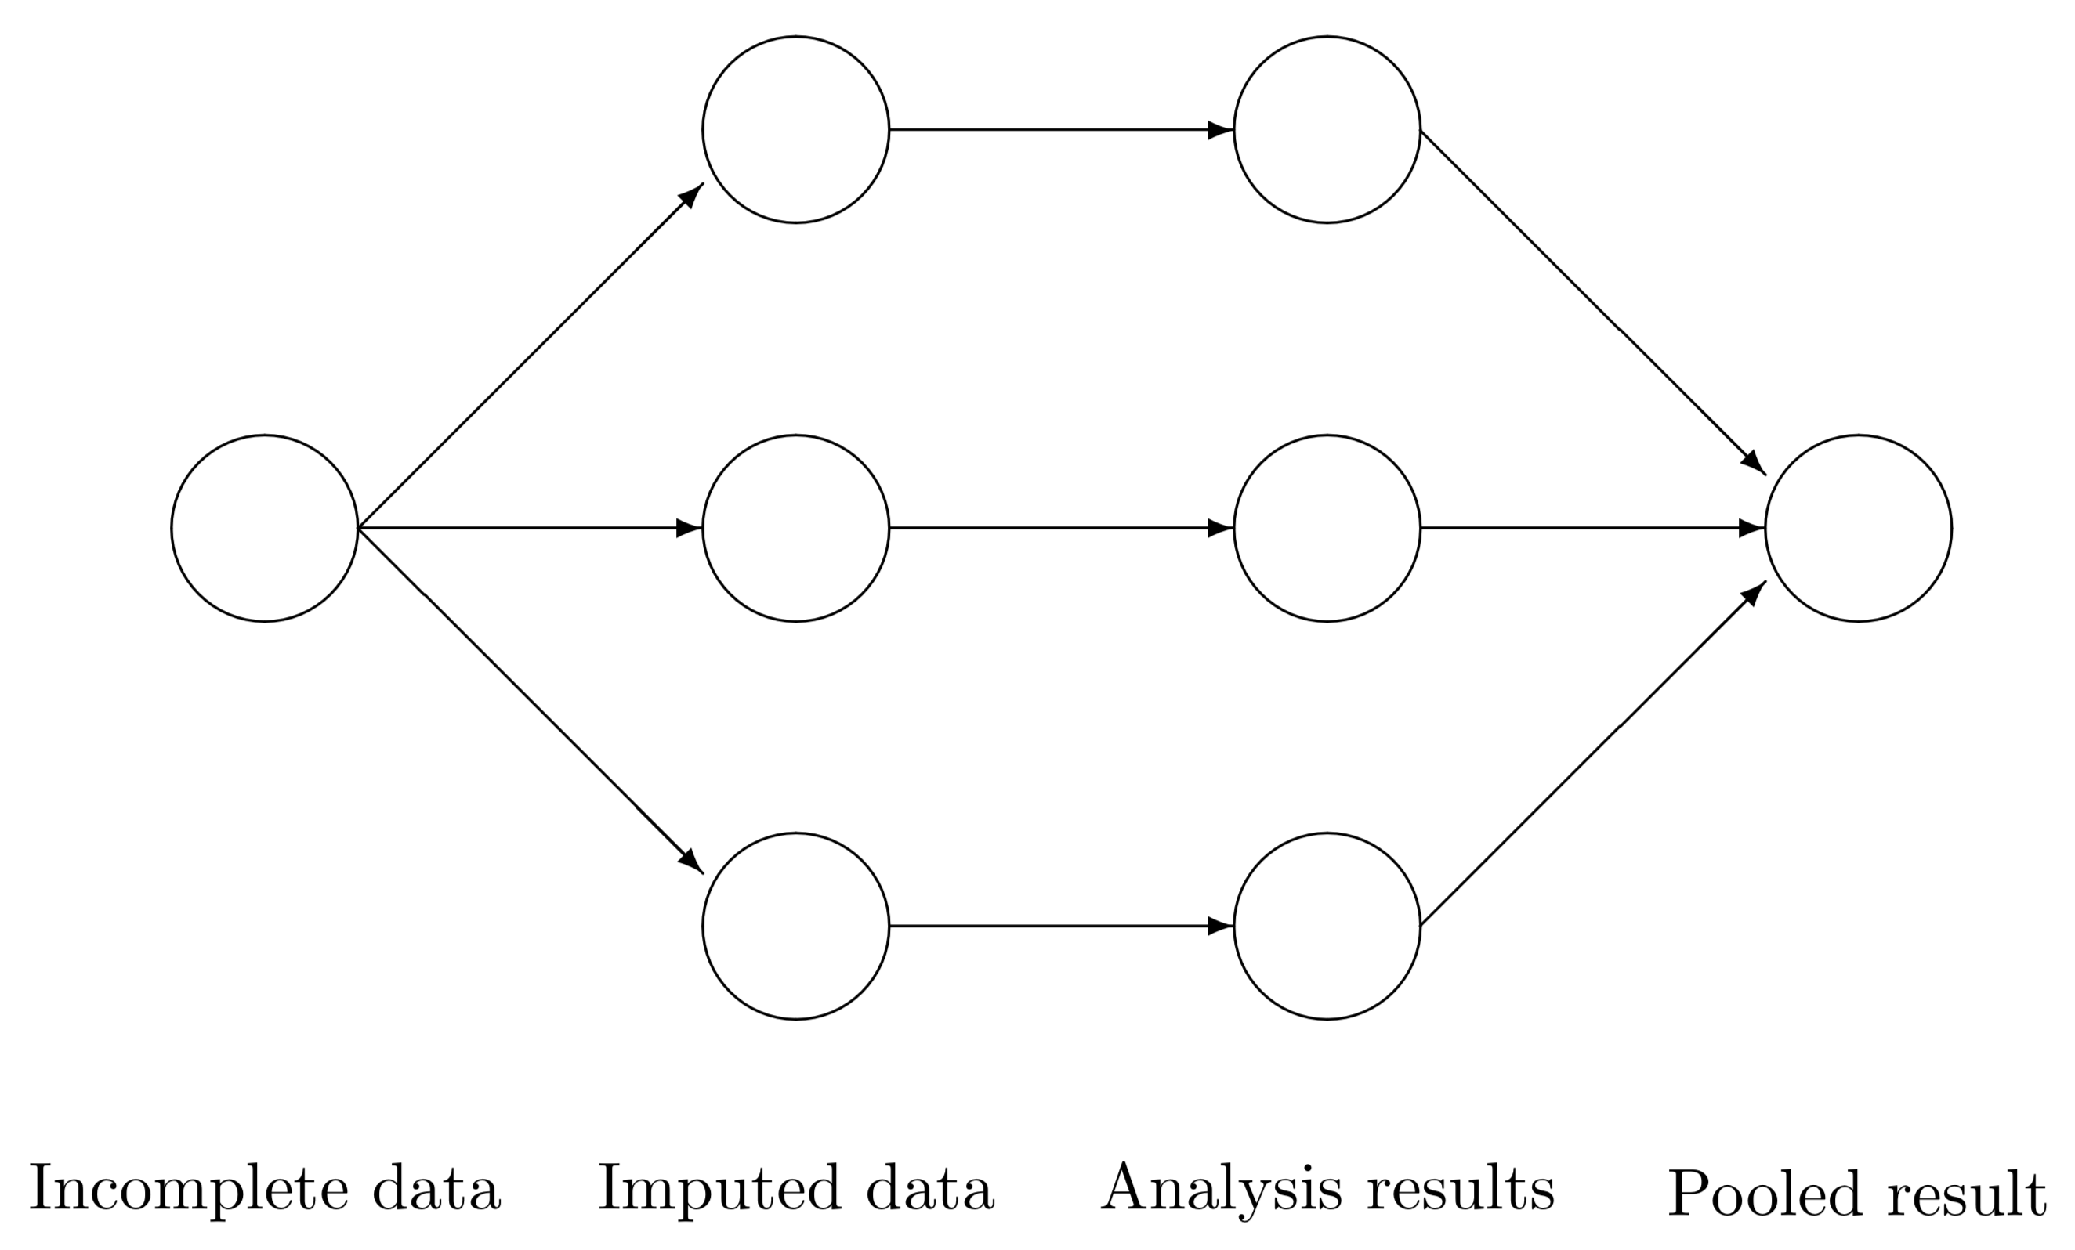
What is synthetic data?
Multiple imputation of missing data
No real personal information
Observed data

Slide 4
The aim of this thesis is to establish a proof-of-concept for generating high-quality partially synthetic data with multiple imputations in MICE for the analysis of privacy-sensitive data.

Slide 5
Research questions
Do the synthetic data and the observed data yield the same statistical inferences, i.e. are the synthetic estimates unbiased and confidence valid?
Can we discriminate between the synthetic data and the observed data with a prediction model?

Slide 6
Outline
Background and contribution
Monte Carlo simulation
Data-generating mechanism
Statistical estimands of interest
Imputation and pooling methods
Performance measures
Results
Discussion: Strengths, limitations and recommendations

Slide 7

Background and contribution
Rubin (1993) and Little (1993)
Promising, but laborious
Exploring the performance of east-to-use software: MICE (Van Buuren and Groothuis-Oudshoorn, 2011)

Slide 8
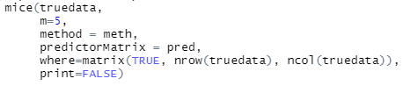
Outline
Simulation study
Data-generating mechanism
Draws from posterior predictive distribution to overimpute
mice-function
Two scenarios: imputed data, semicontinuous data
Pima Indians Diabetes (PID) data set

Slide 9
Scientific estimands
What are we interested in?
Synthetic data preserves
Univariate statistical properties
Multivariate statistical inferences

Slide 10
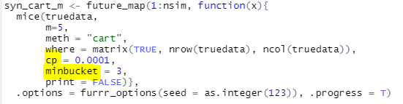
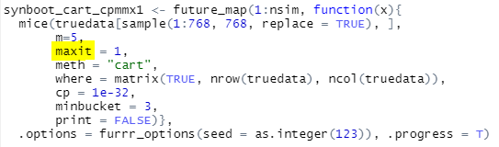
Method Imputation method
Predictive mean matching (PMM)
Classification and regression trees (CART)

Slide 11
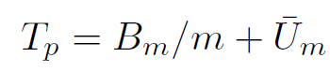
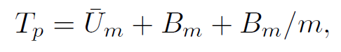
Method Pooling method
Adopted pooling rules for estimation of variance
Partially synthetic data (Reiter, 2003, p. 5)
Rubin’s rules (1987, p. 76)
Observed data

Slide 12
Performance measures
Synthetic estimates vs. ‘true’ observed data
Bias
Confidence validity (Neyman, 1934)
confidence interval coverage (CIC)
confidence interval width (CIW)
Distinguishability

Slide 13
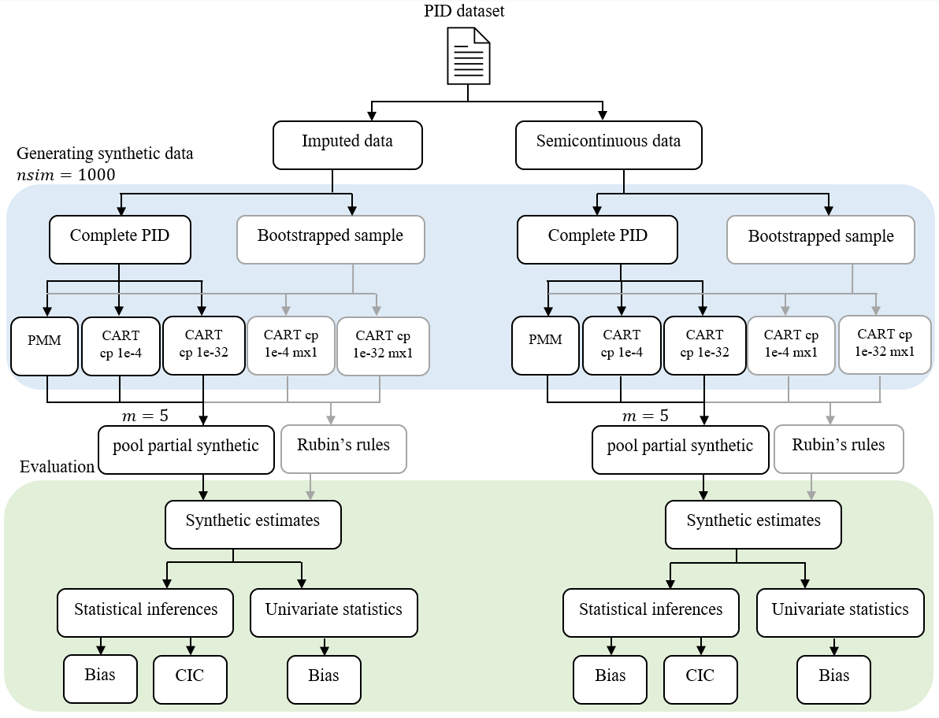
Figure 1: Flowchart simulation study

Slide 14
Results
Performance of MICE generating synthetic data
Multivariate statistical inferences
Univariate statistical properties
Distinguishability

Slide 15
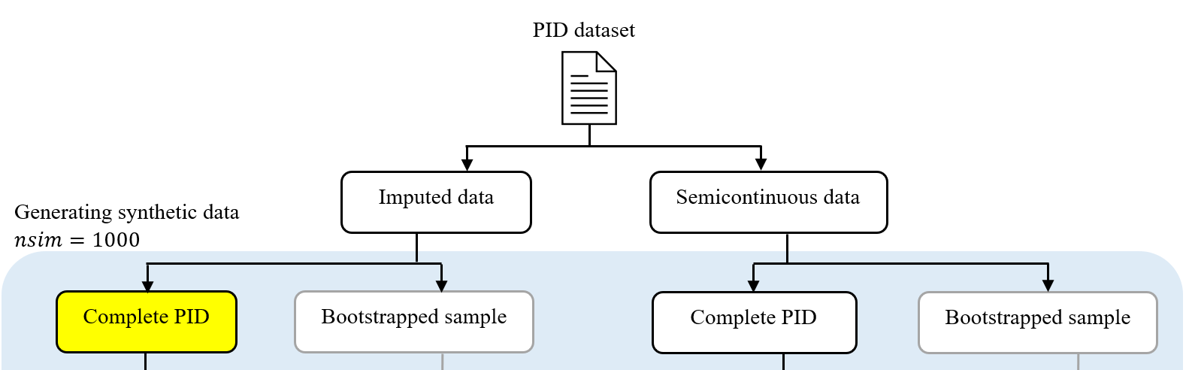
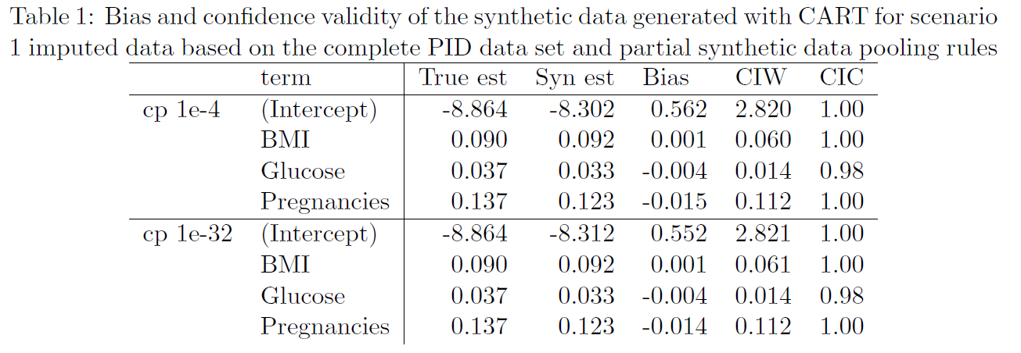
Unbiased Confidence valid
Statistical inferences
Synthetic estimates

Slide 16
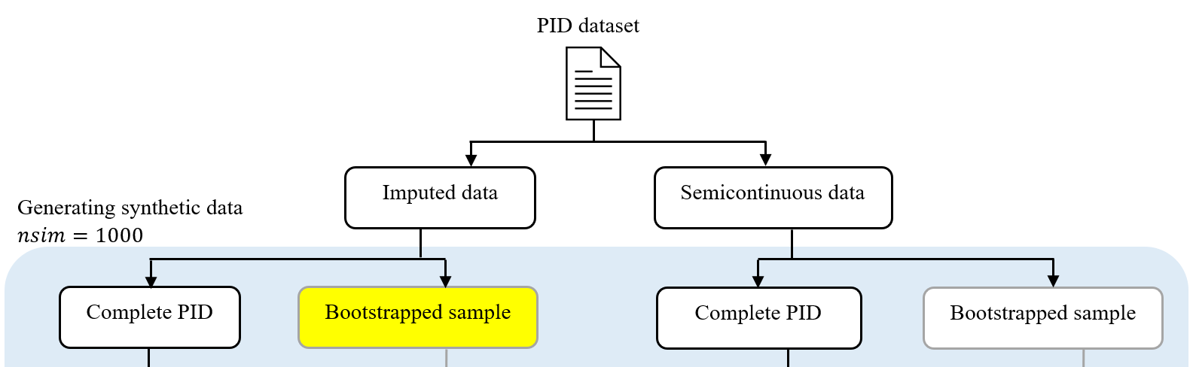
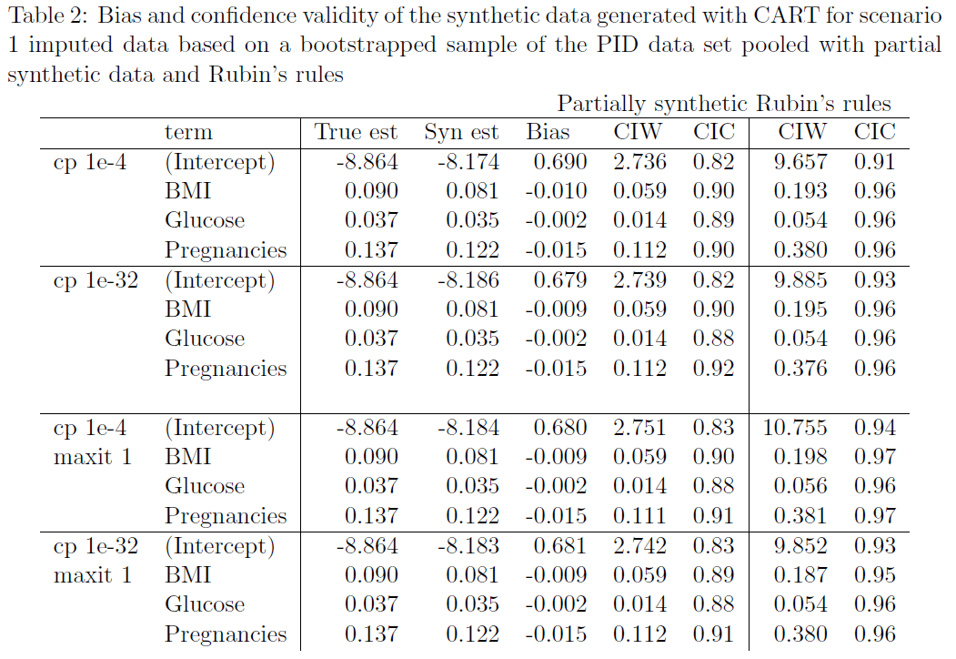
Unbiased Confidence invalid when pooled with partially synthetic Confidence valid when pooled with Rubin’s rules
Statistical inferences

Slide 17
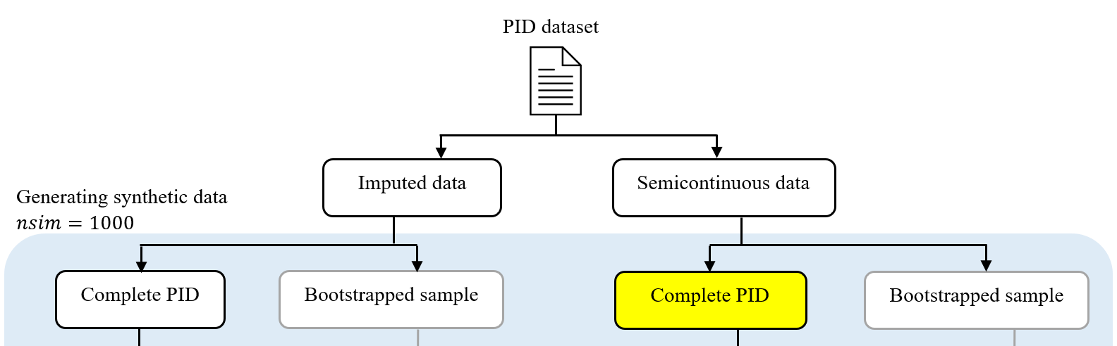
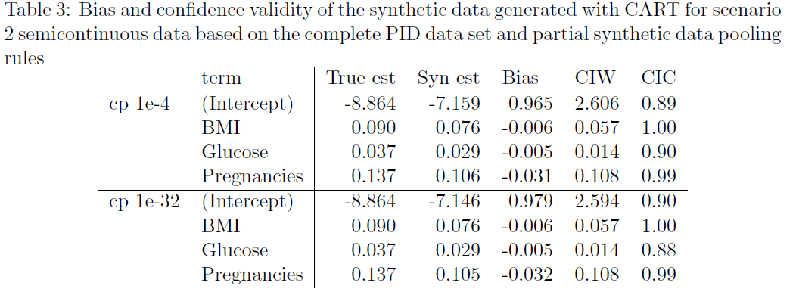
Slight bias for glucose and pregnancies Confidence valid for BMI and pregnancies
Statistical inferences

Slide 18
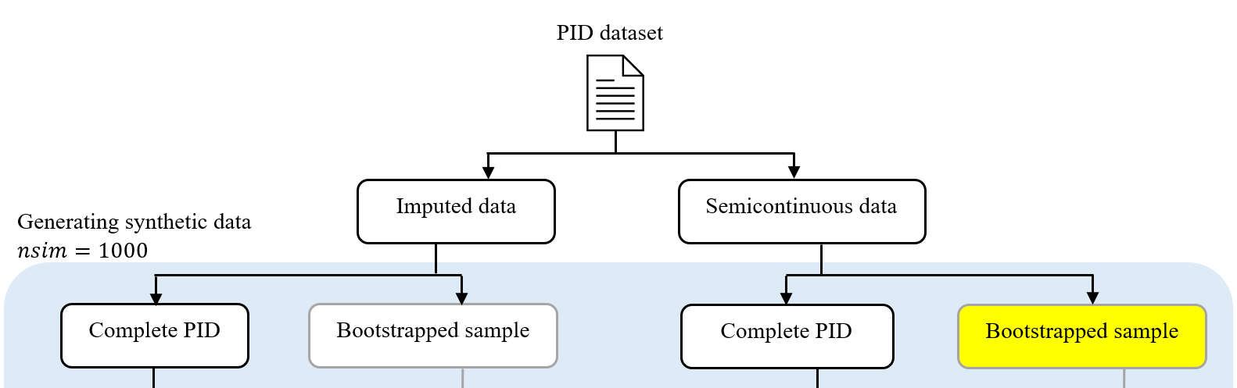
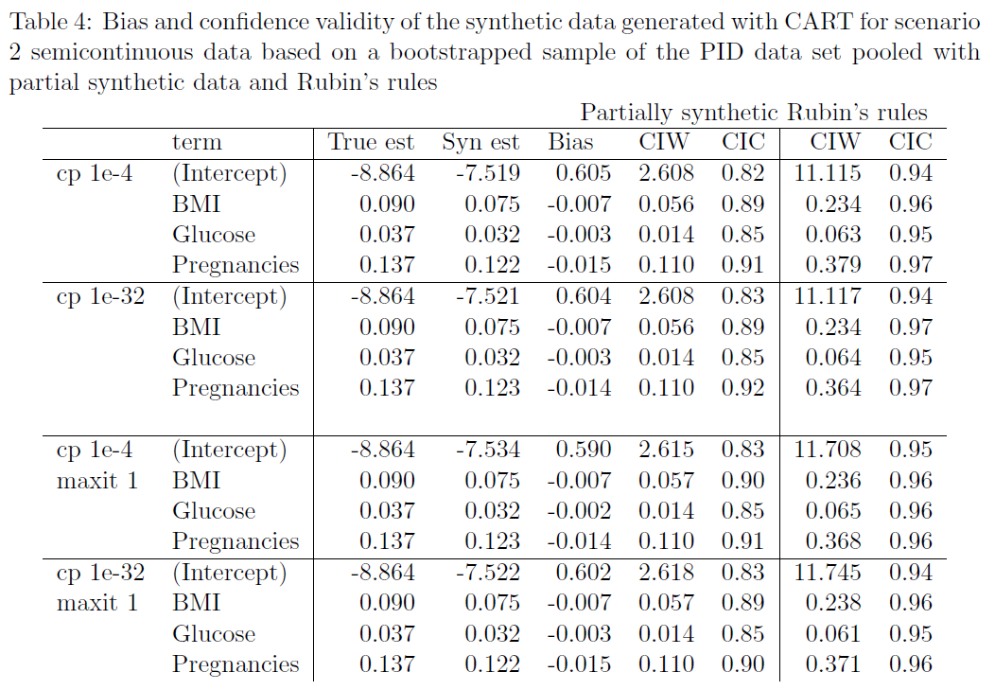
Statistical inferences
Unbiased Confidence invalid when pooled with partially synthetic Confidence valid when pooled with Rubin’s rules

Slide 19
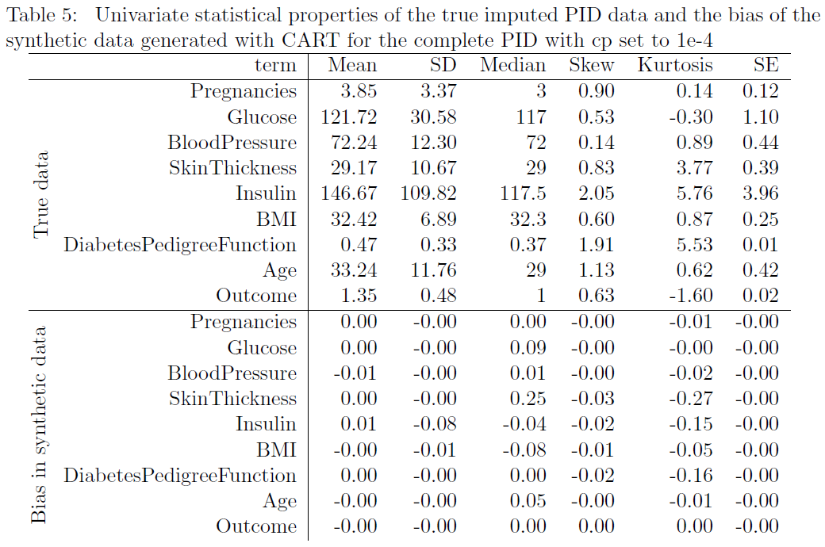
Unbiased
Univariate statistical properties

Slide 20
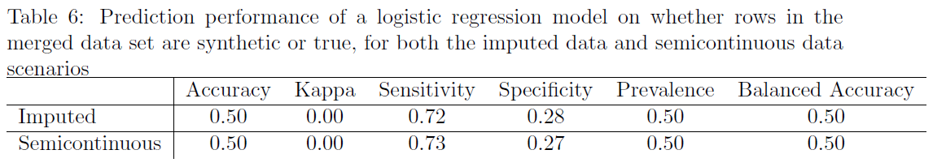
Indistinguishable
Distinguishability synthetic and observed data

Slide 21

Discussion
Do the synthetic data and the observed data yield the same statistical inferences, i.e. are the synthetic estimates unbiased and confidence valid?
Can we discriminate between the synthetic data and the observed data with a prediction model?

Slide 22
Limitations, strengths and recommendations
Quality contingent on imputation method
Uncertainty pooling rules
Disclosure risks
In conclusion, possibilities …
The performance of MICE is promising, especially when we consider the practical implications of easily accessible synthetic data on privacy-preservation in data sharing.

Slide 23

Thank you for your attention
For more information: https://github.com/MMJHendriks/Synthetic_ADS/tree/main/SimulationStudy_MHendriks

Slide 24
References
Burgette, L. F., & Reiter, J. P. (2010). Multiple imputation for missing data via sequential regression trees. American Journal of Epidemiology, 172 (9), 1070-1076. https:// doi.org/10.1093/aje/kwq260
Caiola, G., & Reiter, J. P. (2010). Random forests for generating partially synthetic, categorical data. Transactions on Data Privacy, 3 (1), 27-42. https://dl.acm.org/doi/abs/10.5555/1747335.1747337
Donaldson, M. S., & Lohr, K. N. (1994). Condentiality and privacy of personal data. In M. S. Donaldson & K. N. Lohr (Eds.), Health data in the information age: Use, disclosure, and privacy (pp. 136-226). National Academies Press.
Doove, L. L., Van Buuren, S., & Dusseldorp, E. (2014). Recursive partitioning for missing data imputation in the presence of interaction eects. Computational Statistics & Data Analysis, 72, 92-104. https://doi.org/10.1016/j.csda.2013.10.025
Drechsler, J. (2011). Synthetic Datasets for Statistical Disclosure Control: Theory and Implementation. Springer Science & Business Media. https://doi.org/10.1007/978-1-4614-0326-5
Dusseldorp, E., Conversano, C., & Van Os, B. J. (2010). Combining an additive and tree-based regression model simultaneously: STIMA. Journal of Computational and Graphical Statistics, 19 (3), 514-530. https://doi.org/10.1198/jcgs.2010.06089
Fienberg, S. E., & Steele, R. J. (1998). Disclosure limitation using perturbation and related methods for categorical data. Journal of Official Statistics, 14 (4), 485-502.
Gewin, V. (2016). Data sharing: An open mind on open data. Nature, 529 (7584), 117-119. https://doi.org/10.1038/nj7584-117a
Hayashi, Y., & Yukita, S. (2016). Rule extraction using recursive-rule extraction algorithm with j48graft combined with sampling selection techniques for the diagnosis of type 2 diabetes mellitus in the pima indian dataset.
Informatics in Medicine Unlocked, 2, 92-104. https://doi.org/10.1016/j.imu.2016.02.001
Heeringa, S, Little, R. J. A., & Raghunathan, T. E. (2002). Multivariate imputation of coarsened survey data on household wealth. In R. M. Groves, D. A. Dillman, J. L. Eltinge, & R. J. Little (Eds.), Survey nonresponse (pp. 357-371). Wiley.
Kantarcolu, M., & Vaidya, J. (2018). Secure multiparty computation methods. In L. Liu & M. T. Özsu (Eds.), Encyclopedia of database systems (pp. 3352-3358). Springer. https://doi.org/10.1007/978-1-4614-8265-9 1388
Little, R. J. A. (1988). Missing-data adjustments in large surveys. Journal of Business & Economic Statistics, 6 (3), 287-296. http://dx.doi.org/10.2307/1391878
Little, R. J. A. (1993). Statistical analysis of masked data. Journal of Official Statistics, 9 (2), 407-426.
Loh, W.-Y. (2002). Regression trees with unbiased variable selection and interaction detection. Statistica sinica, 12 (2), 361-386.
Morris, T. P., White, I. R., & Crowther, M. J. (2019). Using simulation studies to evaluate statistical methods. Statistics in Medicine, 38 (11), 2074-2102. https://doi.org/10.1002/sim.8086
Murray, J. S. (2018). Multiple imputation: A review of practical and theoretical findings. Statistical Science, 33 (2), 142-159. https://doi.org/10.1214/18-STS644
National Institute of Diabetes and Digestive and Kidney Diseases. (2016). Pima indians diabetes database: Predict the onset of diabetes based on diagnostic measure [Dataset, Accessed: 2021-04-28]. https://www.kaggle.com/uciml/pima-indians-diabetes-database
Neyman, J. (1934). On the two different aspects of the representative method: The method of stratified sampling and the method of purposive selection. Journal of the Royal Statistical Society, 97 (4), 558-625. https://doi.org/10.1007/978-1-4612-4380-9 12
R Core Team. (2021). R: A language and environment for statistical computing. R Foundation for Statistical Computing. Vienna, Austria. https://www.R-project.org/
Raghunathan, T. E., Reiter, J. P., & Rubin, D. B. (2003). Multiple imputation for statistical disclosure limitation. Journal of Official Statistics, 19 (1), 1-16.
Reiter, J. P. (2002). Satisfying disclosure restrictions with synthetic data sets. Journal of Official Statistics, 18 (4), 531-544.
Reiter, J. P. (2003). Inference for partially synthetic, public use microdata sets. Survey Methodology, 29 (2), 181-188.
Reiter, J. P. (2005a). Releasing multiply imputed, synthetic public use microdata: An illustration and empirical study. Journal of the Royal Statistical Society: Series A, 168 (1), 185-205. https://doi.org/10.1111/j.1467-985X.2004.00343.x
Reiter, J. P. (2005b). Signicance tests for multi-component estimands from multiply imputed, synthetic microdata. Journal of Statistical Planning and Inference, 131 (2), 365-377. https://doi.org/10.1016/j.jspi.2004.02.003
Reiter, J. P. (2005c). Using cart to generate partially synthetic public use microdata. Journal of Official Statistics, 21 (3), 441-462.
Reiter, J. P., & Drechsler, J. (2010). Releasing multiply-imputed synthetic data generated in two stages to protect condentiality. Statistica Sinica, 20 (1), 405-421. http://www.jstor.org/stable/24308998
Reiter, J. P., & Mitra, R. (2009). Estimating risks of identication disclosure in partially synthetic data. Journal of Privacy and Confidentiality, 1 (1), 99-110. https://doi.org/10.29012/jpc.v1i1.567
Reiter, J. P., & Raghunathan, T. E. (2007). The multiple adaptations of multiple imputation. Journal of the American Statistical Association, 102 (480), 1462-1471. https://doi.org/10.1198/016214507000000932
Rubin, D. B. (1987). Multiple imputation for nonresponse in surveys. John Wiley & Sons. https://doi.org/10.1002/9780470316696
Rubin, D. B. (1993). Discussion: Statistical disclosure limitation. Journal of Official Statistics, 9 (2), 461-468.
Utrecht University. (2020). Open science. https ://www.uu. nl/sites/default/les/ubd strategic plan utrecht university 2016-2020.pdf
Van Buuren, S. (2018). Flexible Imputation of Missing Data (Second Edition). CRC press: Taylor & Francis Group. https://doi.org/10.1201/9780429492259
Van Buuren, S. (2021). Package 'mice'. R package version 3.13.0. https://cran.r-project.org/web/packages/mice/mice.pdf
Van Buuren, S., & Groothuis-Oudshoorn, K. (2011). Mice: Multivariate imputation by chained equations in R. Journal of Statistical Software, 45 (3), 1-68. https://doi.org/10.18637/jss.v045.i03
Vink, G., Frank, L. E., Pannekoek, J., & Van Buuren, S. (2014). Predictive mean matching imputation of semicontinuous variables. Statistica Neerlandica, 68 (1), 61-90. https://doi.org/10.1111/stan.12023
Vink, G., & Van Buuren, S. (2014). Pooling multiple imputations when the sample happens to be the population. arXiv preprint arXiv:1409.8542. http://arxiv.org/abs/1409.8542
Volker, T. B. (2021). Synthetic data with mice [source code]. https://github.com/amices/Federated imputation/blob/master/mice synthesizing/simulations/functions.R
Yin, Y., Kaku, I., Tang, J., & Zhu, J. (2011). Privacy-preserving data mining. In Y. Yin, I. Kaku, J. Tang, & J. Zhu (Eds.), Data mining (pp. 101{119). Springer. https://doi.org/10.1007/978-1-84996-338-1 6
Yu, L.-M., Burton, A., & Rivero-Arias, O. (2007). Evaluation of software for multiple imputation of semi-continuous data. Statistical Methods in Medical Research, 16 (3), 243-258. https://doi.org/10.1177/0962280206074464

